Slide 1
Changes in the Earth System
November 5, 2019

Slide 2
Have we entered a new epoch?

Slide 3
The Case for the Anthropocene
Proposed new epoch that has resulted primarily from human changes to the planet’s:
Elemental cycles
Climate
Biological diversity

Slide 4
The Case for the Anthropocene
Proposed new epoch that has resulted primarily from human changes to the planet’s:
Elemental cycles
Climate
Biological diversity

Slide 5
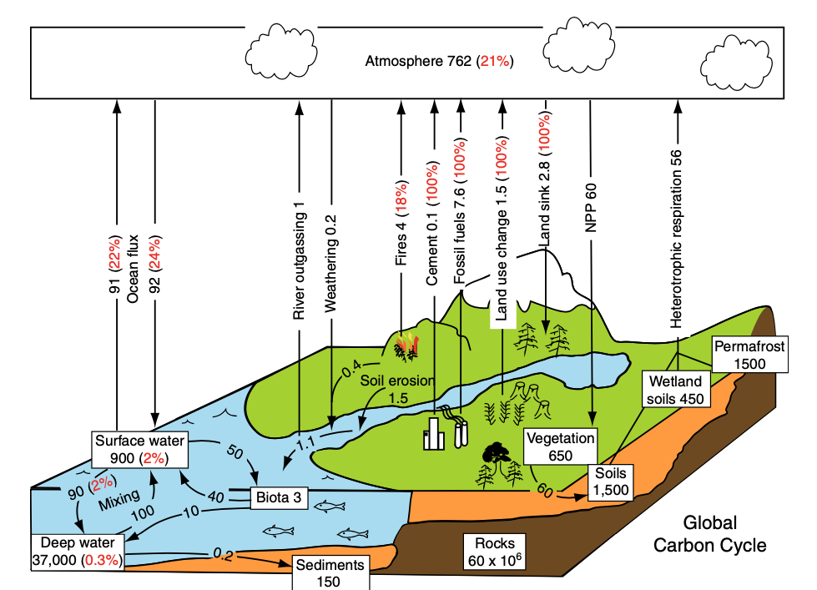
Chapin et al. (2011)

Slide 6
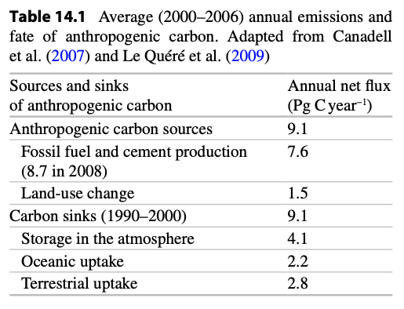
Balanced?

Slide 7
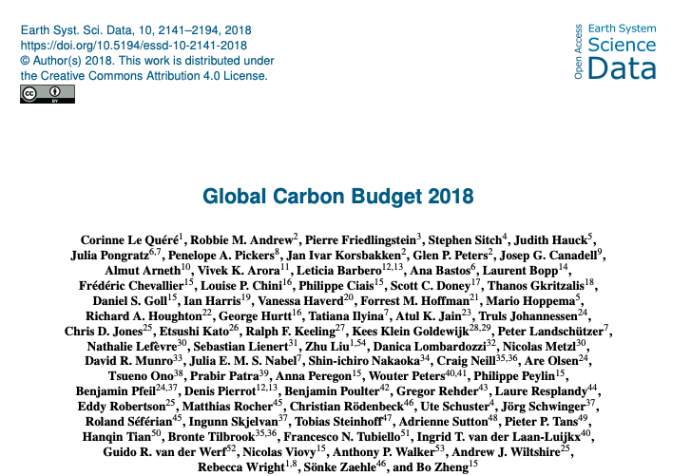
Flux | Amount (GtC/yr)
Fossil fuel burning | 9.4
LULCC | 1.5
Ocean uptake | 2.4
Land uptake | 3.2
Atmospheric growth | 4.7
Uncertainty | 0.5
Note: this is CO₂ only

Slide 8
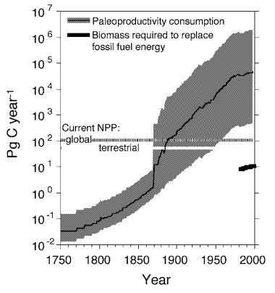
We are using more carbon than plants are putting back
Dukes (2003) “Burning buried sunshine”

Slide 9
Going up 5 ppm / year

Slide 10
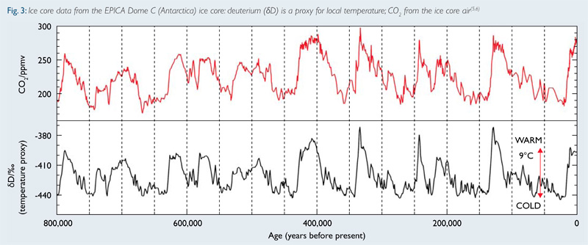
Historical rate of change: 0.002 ppm / year

Slide 12
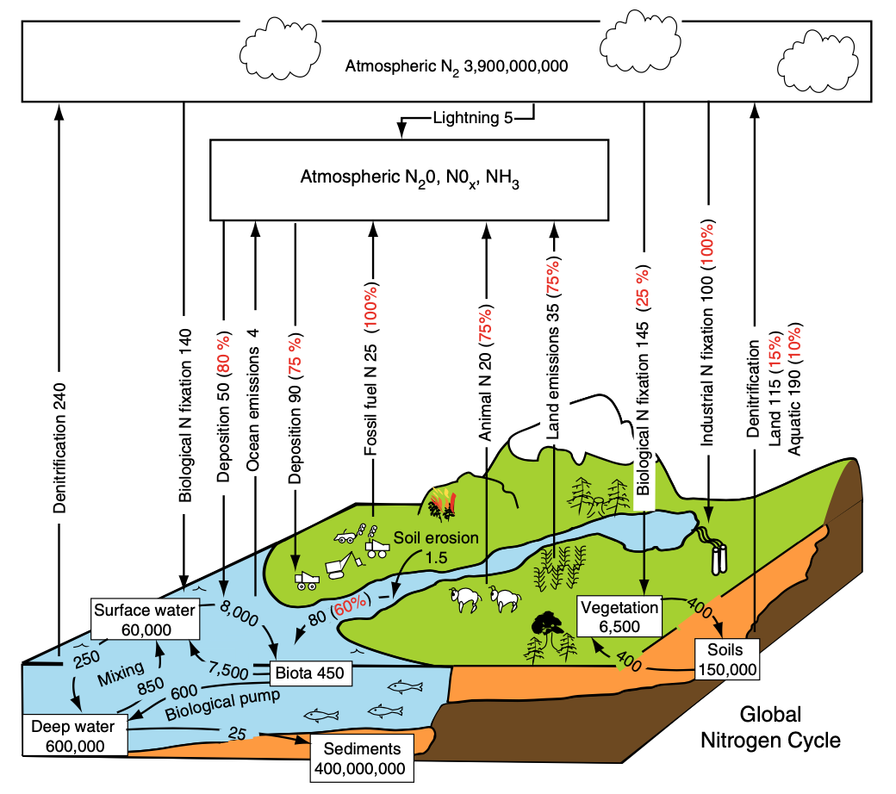
Chapin et al. (2011)

Slide 13
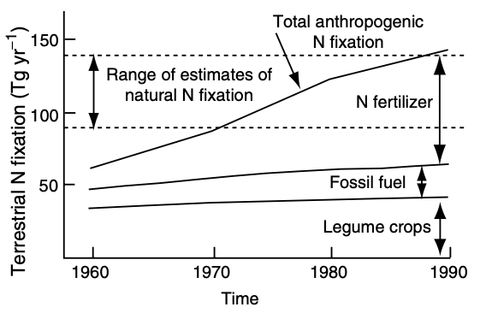
We’re pulling in a lot of atmospheric N…

Slide 14
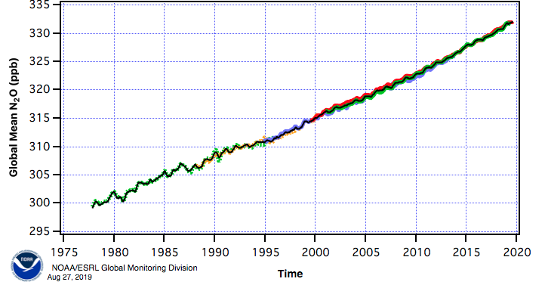
…while also pumping out a lot in new forms

Slide 15
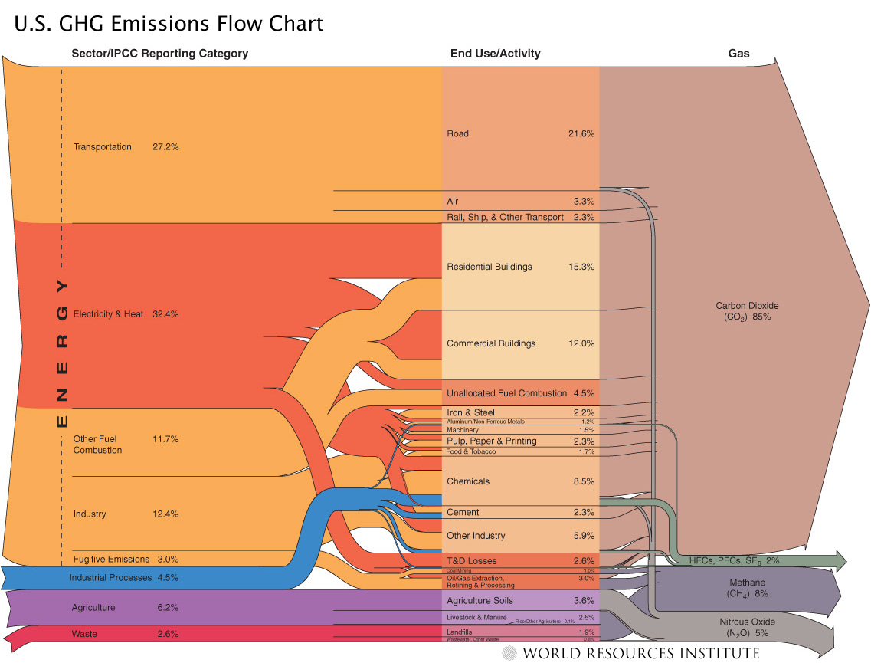

Slide 16
The Case for the Anthropocene
Proposed new epoch that has resulted primarily from human changes to the planet’s:
Elemental cycles
Climate
Biological diversity

Slide 17
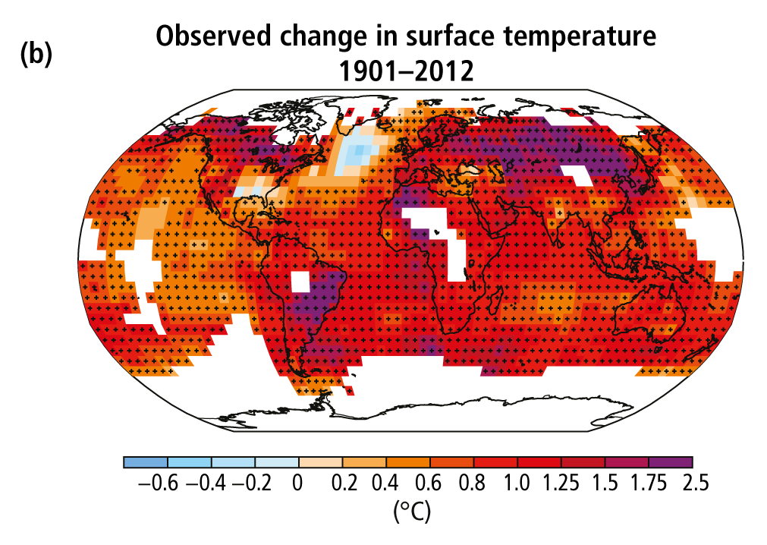
IPCC (2013)

Slide 18
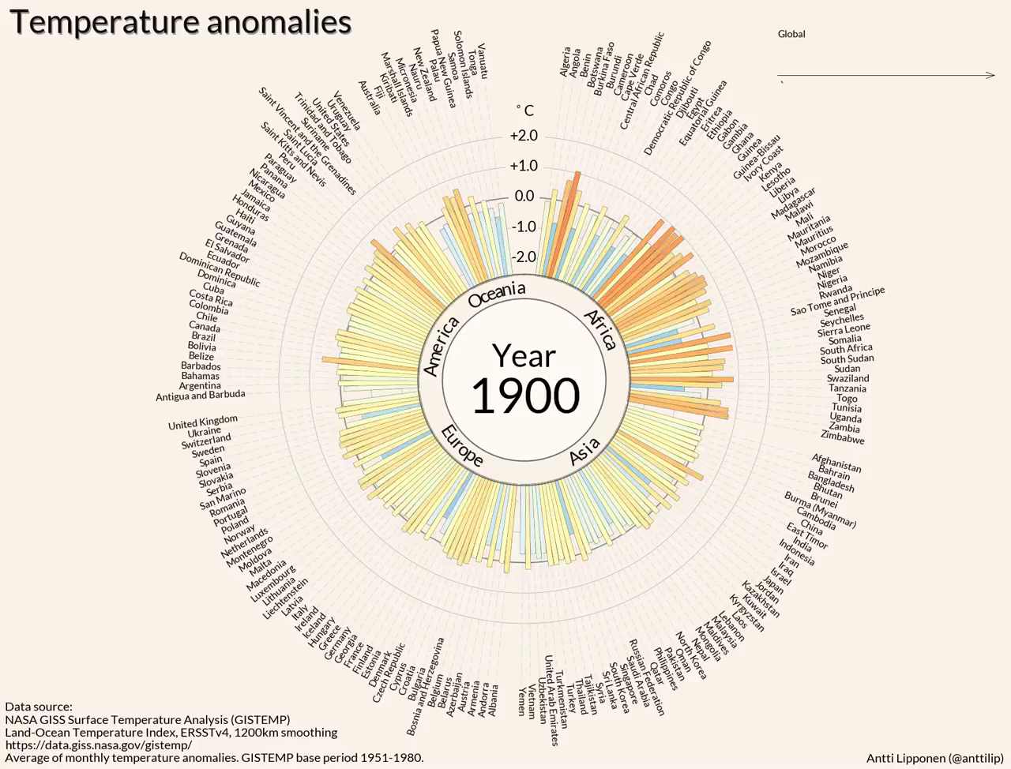

Slide 19
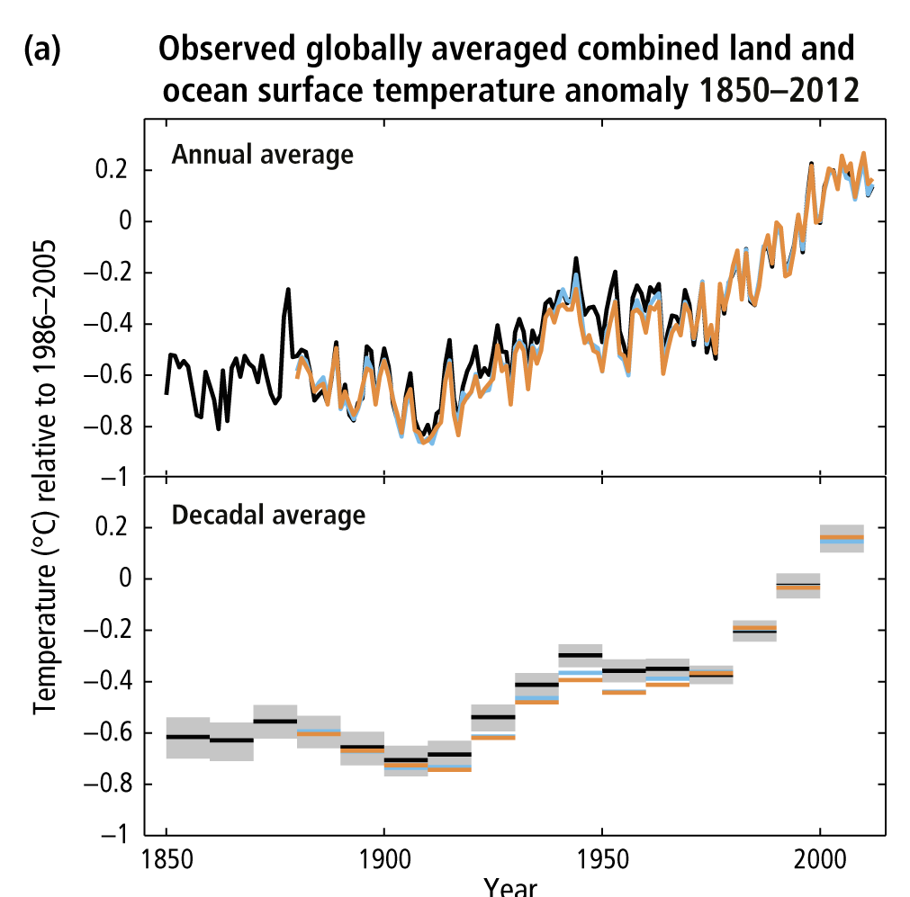
The global mean temperature has increased ~1.5º F (0.8º C) over the past 150 years
Notes:
Figure SPM.1: (a) Observed global mean combined land and ocean surface temperature anomalies, from
1850 to 2012 from three data sets. Top panel: annual mean values, bottom panel: decadal mean values
including the estimate of uncertainty for one dataset (black). Anomalies are relative to the mean of
1961−1990. For a listing of the datasets and further technical details see the Technical Summary Supplementary
Material. {Figures 2.19–2.21; Figure TS.2}

Slide 20
Increase is 0.07°C / decade since 1880;
0.17°C / decade since 1970
Notes:
Figure SPM.1: (a) Observed global mean combined land and ocean surface temperature anomalies, from
1850 to 2012 from three data sets. Top panel: annual mean values, bottom panel: decadal mean values
including the estimate of uncertainty for one dataset (black). Anomalies are relative to the mean of
1961−1990. For a listing of the datasets and further technical details see the Technical Summary Supplementary
Material. {Figures 2.19–2.21; Figure TS.2}

Slide 21
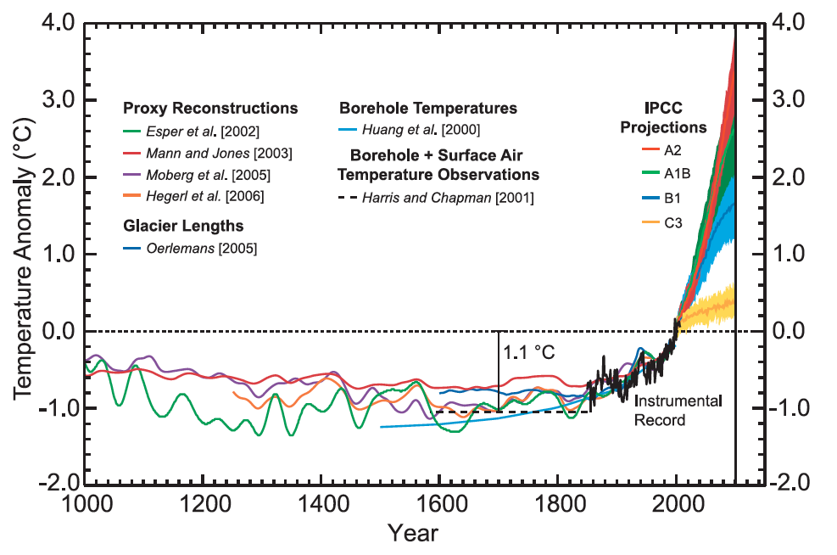
Chapman & Davis 2010

Slide 22
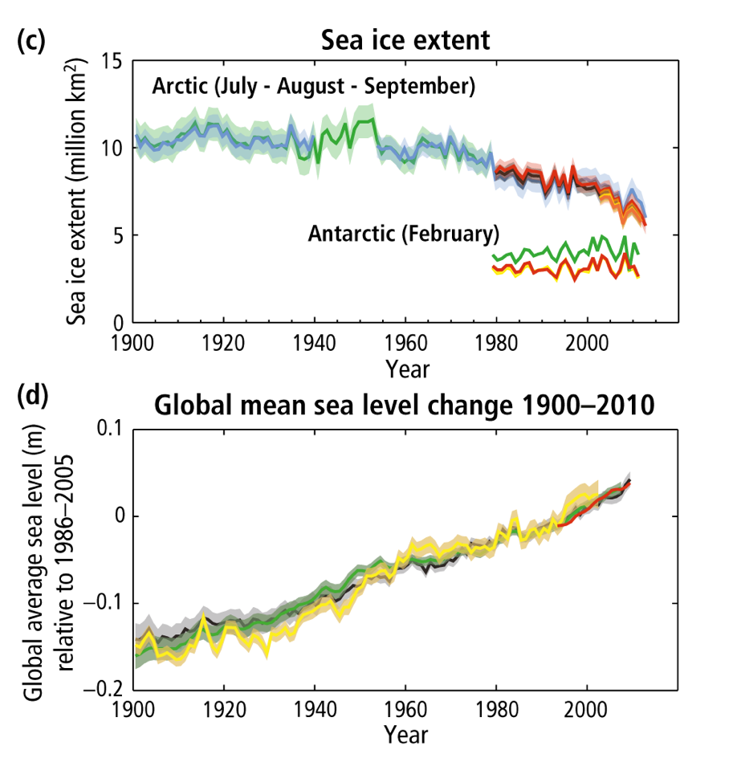

Slide 23
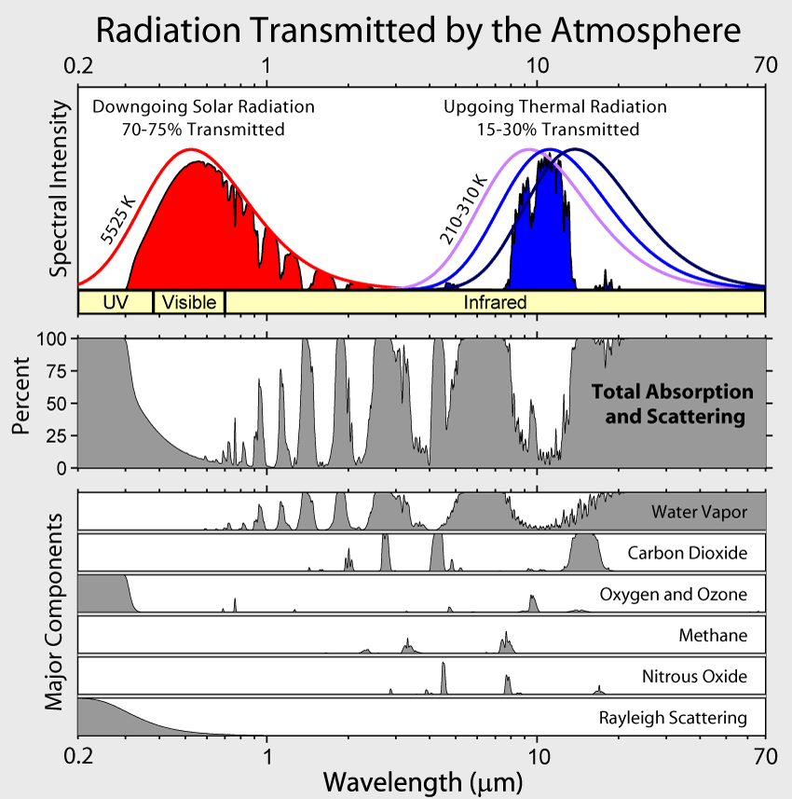

Slide 24
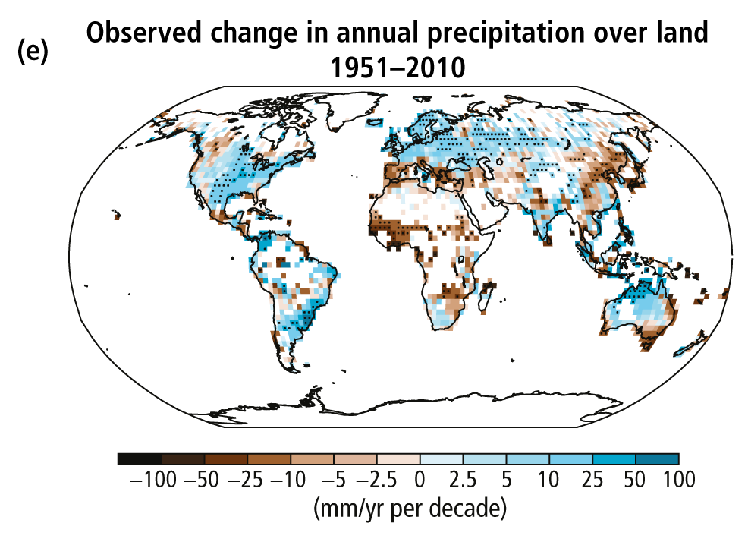
NCA 2014

Slide 25
Increase in heaviest 1% precipitation (U. Michigan)

Slide 26
The Case for the Anthropocene
Proposed new epoch that has resulted primarily from human changes to the planet’s:
Elemental cycles
Climate
Biological diversity

Slide 27
IPBES

Slide 28
Invasive species are spreading…

Slide 29
Early et al. (2016)

Slide 30
Early et al. (2016)

